Slide 1

Lecture 10: SQL, HTML, and CSS
Intro to Data Science for Public Policy
Spring 2017
Jeff Chen + Dan Hammer

Slide 2
Roadmap
Homeworks #3 + #4
SQL + how data is really stored
<break/>
HTML, CSS + web pages
Intro to Data Science for Public Policy, Spring 2017

Slide 3
Homework #3
Smoothness of code
Mean F1s
Homework #3

Slide 4
What made for a good model?
Homework #3
y(f1) = f(terms in optimal equations)
Coef | Value
(Intercept) – Base perf | 0.758
randomForest | 0.057
accel | 0.053
avg50 | 0.029
type | 0.011
user_acc_y.G. | 0.010
avg100 | 0.009
k | 0.000
min50 | -0.041
knn | -0.254
Explicitly including accel and avg100 variables
Random Forests did better
Decision trees (“type”) were about average
KNNs yielded less accurate results
Homework #3

Slide 5
Roadmap
Homeworks #3 + #4
SQL + how data is really stored
<break/>
HTML, CSS + web pages
Intro to Data Science for Public Policy, Spring 2017

Slide 6
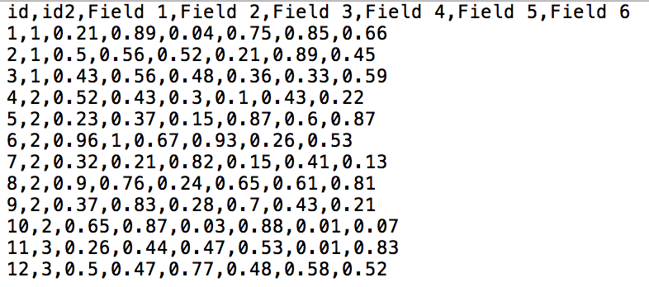
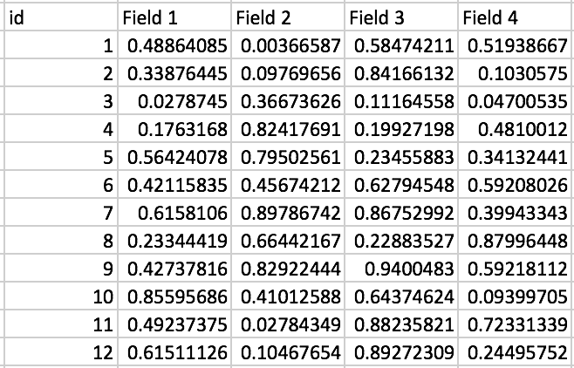
In most data courses, we assume that data is available in CSVs, which then can be manipulated in R/Python using data frames
CSV
Data Frame
SQL

Slide 7
Database 1
The CSV might be a custom view from a database.
Views are the results of a pre-defined query.
What if you need to build your own view?
Table 1
Table 2
Table 3
Table 4
Table 5
SQL

Slide 8
Option #1
Download the whole database and export individual tables.
Not recommended as databases can be huge
Database 1
SQL

Slide 9
Option #2
Beg the database administrator (the gate keeper) to build specific views and extract tables for you.
Too many custom modifications means your work will be largely dependent on one person to give you data.
Oh, exalted one, I missed a variable in my previous request...
Silence, database mortal!
Lord Administrator of Database
SQL

Slide 10
Option #3
Learn to query databases using Structured Query Language or SQL
Structured Query Language (See-Qwell or S. Q. L.) is used to interact with and manage relational databases.
SQL call
extract
Database 1
SQL

Slide 11
What’s a Relational Database
Relational databases organizes information into one or more tables such that each table is an entity type, a columns contain attributes that describe the entity and may be used to link tables
ssn | firstname | lastname
123-45-6789 | john | Sobrenome
912-34-5678 | Jorge | Apellido
891-23-4567 | Gianni | Cognome
id | ssn | state | income
1 | 123-45-6789 | 1 | $100,000
2 | 912-34-5678 | 1 | $30,000
3 | 891-23-4567 | 3 | $75,000
state | desc
1 | New York
2 | Virginia
3 | Washington
SQL

Slide 12
SQL
CRUD Operations
CRUD Operations are four basic operations that SQL can help undertake in a database
Create – INSERT statement
Read – SELECT statement
Update – UPDATE statement
Delete – DELETE statement
SQL

Slide 13
SQL
CRUD Operations
CRUD Operations are four basic operations that SQL can help undertake in a database
Create – INSERT statement
Read – SELECT statement
Update – UPDATE statement
Delete – DELETE statement
Data scientists and analysts largely work in this step but may occasionally work with all four
SQL

Slide 14
SQL
A few examples
SELECT *
FROM tbl
R equivalent
> tbl
”Retrieve all fields (*) and records FROM table named tbl”
SQL

Slide 15
SQL
A few examples
SELECT income
FROM tbl
R equivalent
> tbl[, c(“income”)]
”Retrieve ’income’ field and records FROM table named tbl”
SQL

Slide 16
SQL
A few examples
SELECT income, state
FROM tbl
R equivalent
> tbl[, c(“income”,”state”)
”Retrieve ’income’ and ‘state’ fields and records FROM table named tbl”
SQL

Slide 17
SQL
A few examples
SELECT income, state
FROM tbl
LIMIT 10
R equivalent
> tbl[1:10, c(“income”,”state”)
”Retrieve first 10 records of ’income’ and ‘state’ fields FROM table named tbl”
SQL

Slide 18
SQL
A few examples
SELECT income, state
FROM tbl
WHERE region = ’Midwest’
LIMIT 10
R equivalent
> a <- tbl[tbl$region == “Midwest”, c(“income”,”state”)
> b <- a[1:10,]
”Retrieve first 10 records of ’income’ and ‘state’ fields FROM table named tbl if region is in the ’Midwest’ ”
SQL

Slide 19
SQL
How to use
Usually, SQL statements would be executed via command line or an Interactive Development Environment (IDE) to interact with databases
In R, SQL can only be used via the library sqldf, which operates on data frames.
Good way to get accustomed
SQL

Slide 20
<Code Time/>
SQL

Slide 21
Roadmap
Homeworks #3 + #4
SQL + how data is really stored
<break/>
HTML, CSS + web pages
Intro to Data Science for Public Policy, Spring 2017

Slide 22
Roadmap
Homeworks #3 + #4
SQL + how data is really stored
<break/>
HTML, CSS + web pages
Intro to Data Science for Public Policy, Spring 2017

Slide 23
Why should we focus on websites in data science and public policy?
While the main value of data science is the algorithmic outputs and understanding, websites and visualizations are used as “proxies of productivity” for non-technical audiences
Fewer people on the business/strategy side understand how web projects work, but expect something to be done – regardless of how it works [recipe for disaster]
HTML/CSS

Slide 24
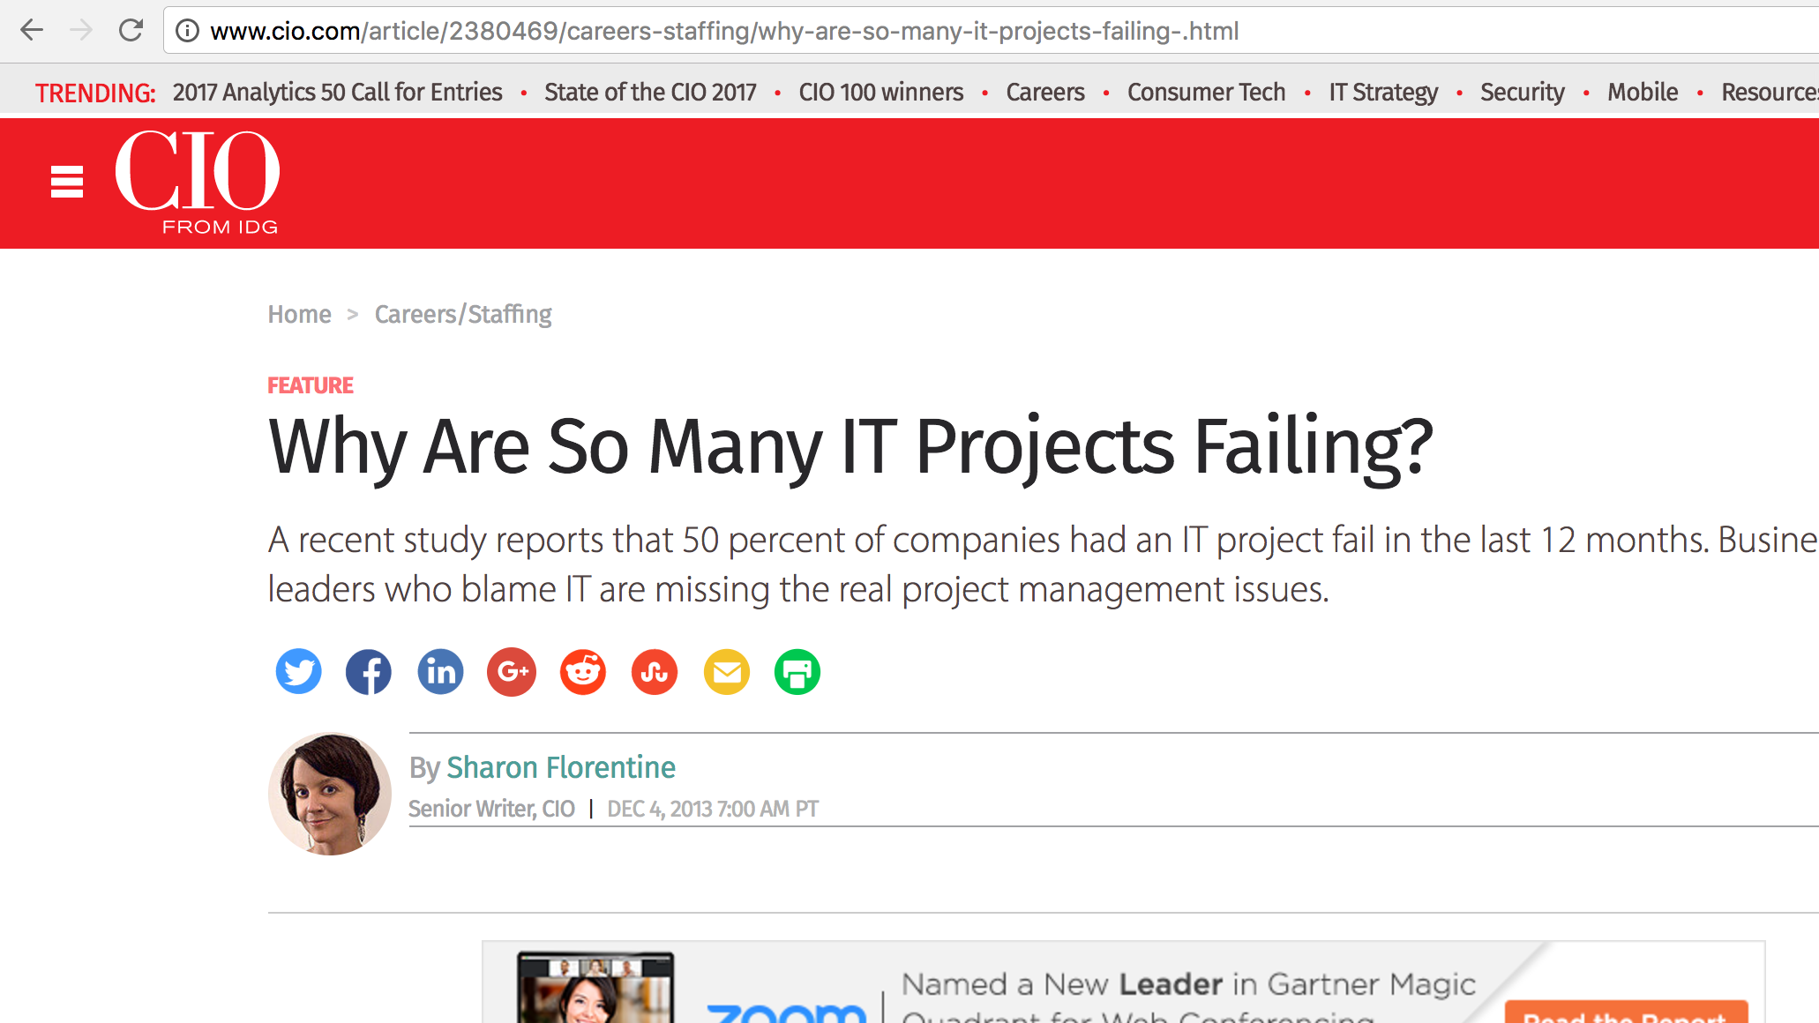
[]
HTML/CSS

Slide 25
[]
“We've moved away from an era of hardware and operating systems and it's all about applications. Nobody on the business side cares how solutions are delivered, they care about the value of the application.”
HTML/CSS

Slide 26
HTML/CSS

Slide 27
Point of Part 2 of Today
Provide enough of an understanding of web technologies
Develop a basic understanding of what goes into a website
HTML/CSS

Slide 28
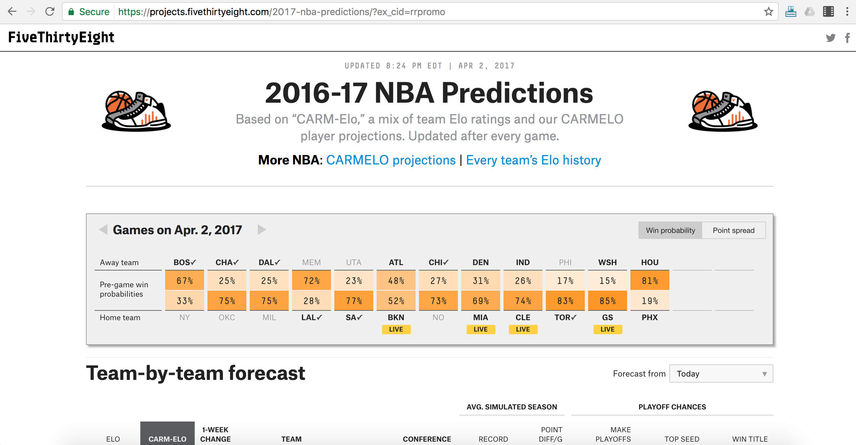
What we see in the browser
[]
HTML/CSS

Slide 29
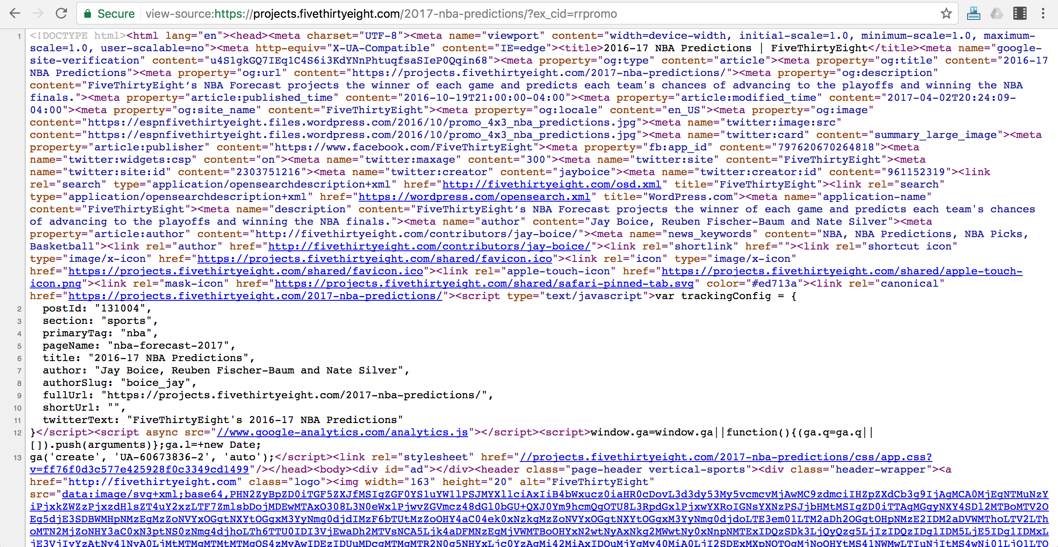
What the browser sees
[]
HTML/CSS

Slide 30
What the browser sees
[]
Most websites use
Hypertext Markup Language (HTML)
to codify the structure and contents of a web page.
HTML/CSS

Slide 31
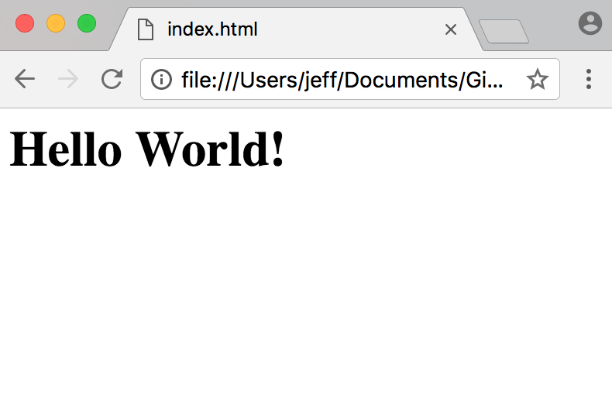
HTML
<html>
<body>
<h1> Hello World!</h1>
</body>
</html>
HTML/CSS

Slide 32
HTML
text in <> are “tags”
Each tag represents a type of content
<html> = root element of structure
<body> = contains visible content
<h1> = large heading
<html>
<body>
<h1> Hello World!</h1>
</body>
</html>
HTML/CSS

Slide 33
HTML
<h1> Hello World!</h1>
<tags> tend to come in pairs to indicate where the element starts and ends.
HTML/CSS

Slide 34
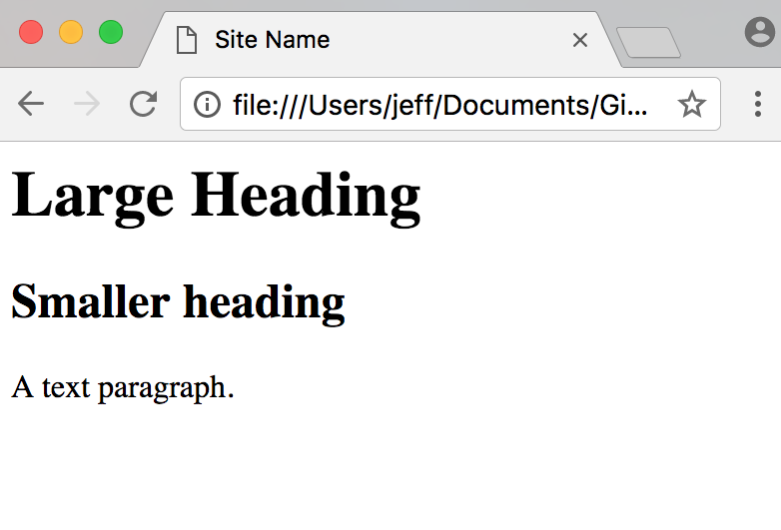
HTML
<!DOCTYPE html>
</html>
<head>
<style> </style>
<title> Site Name </title>
</head>
<body>
<h1> Large heading </h1>
<h2> Smaller heading </h2>
<p> A text paragraph. </p>
</body>
HTML/CSS

Slide 35
HTML: Tags Galore
Basics
<body>
<html>
<title>
Sections
<div>
<section>
Images
<img>
<picture>
<canvas>
Tables
<table>
<td>
<th>
<tr>
There are many types of tags that can be creatively strung together to structure of webpage.
Text
<h1>
<h2>
<h3>
<h4>
<h5>
<p>
Breaks
<hr>
<br>
Frames
<iframe>
Styles
<style>
<head>
Lists
<ul>
<ol>
<li>
Links
<a>
<nav>
Programming
<script>
HTML/CSS

Slide 36
HTML
But how about the styles?
(who wants a website from the 90’s?)
HTML/CSS

Slide 37
What the browser sees
[]
Most websites use
Cascading Style Sheets (CSS)
to format the HTML.
HTML/CSS

Slide 38
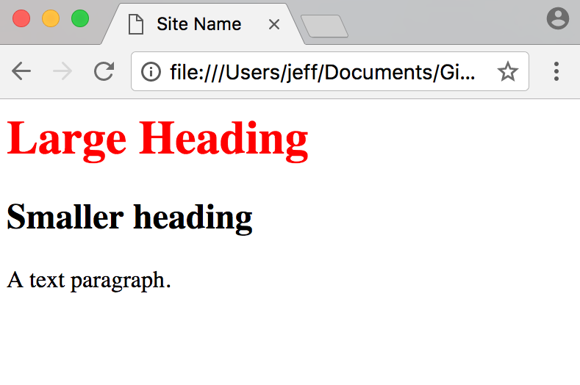
HTML + CSS
CSS can be included in the <style> tag to format all <h1> tags as red.
<!DOCTYPE html>
</html>
<head>
<style>
h1{
color: red;
}
</style>
<title> Site Name </title>
</head>
<body>
<h1> Large heading </h1>
<h2> Smaller heading </h2>
<p> A text paragraph. </p>
</body>
HTML/CSS

Slide 39
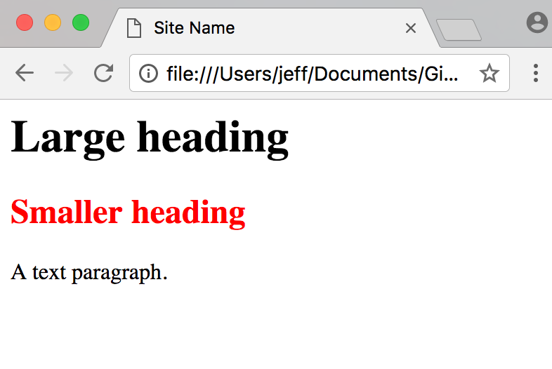
HTML + CSS
CSS can be used to define a ”class” of formats that can be applied anywhere the class is referenced.
<!DOCTYPE html>
</html>
<head>
<style>
.col1{
color: red;
}
</style>
<title> Site Name </title>
</head>
<body>
<h1 Large heading </h1>
<h2 class="col1"> Smaller </h2>
<p> A text paragraph. </p>
</body>
HTML/CSS

Slide 40
HTML + CSS
CSS can be called into the HTML file from a .css file
index.html
<!DOCTYPE html>
</html>
custom.css
<head>
<link rel="stylesheet" href='css/custom.css' rel='stylesheet' type='text/css'>
<title> Site Name </title>
</head>
.col1{
color: red;
}
<body>
<h1 Large heading </h1>
<h2 class="col1"> Smaller </h2>
<p> A text paragraph. </p>
</body>
HTML/CSS

Slide 41
A short aside
[]
Most websites use
JavaScript (JS)
to add interactivity and data handling capabilities.
HTML/CSS

Slide 42




There are many libraries built on JavaScript (JS) including:
A short aside
(Not covered in this course)
HTML/CSS

Slide 43
HTML + CSS
CSS can be included in the <style> tag to format all <h1> tags as red.
<!DOCTYPE html>
</html>
<head>
<style>
h1{
color: red;
}
</style>
<title> Site Name </title>
</head>
<body>
<h1> Large heading </h1>
<h2> Smaller heading </h2>
<p> A text paragraph. </p>
</body>
HTML/CSS

Slide 44
<Code Time/>
HTML/CSS

